Slide 1
Important thing about the class
Come before I enter the class.
Attendance criteria
Maintain a notebook(200 pages long book) for CC.

Slide 2
Cloud Computing (PE6-ICT 4045)

Slide 3
Objectives:
To learn the fundamental concepts and various delivery, deployment models in cloud computing.
To understand the demand and need based allocation of resources to the applications running in cloud
To familiarize with the role of virtualization layer, various types of virtualization techniques.
To understand various techniques to secure the cloud resources from unauthorized access.
.

Slide 4
Abstract:
Introduction, Cloud infrastructure, Cloud computing delivery models and services, Cloud computing at Amazon, The Google perspective, Microsoft Windows Azure, Application paradigms, Architectural styles of cloud computing, Cloud resource management and scheduling, Cloud resource virtualization, Types of virtualization, Understanding hypervisors, Virtual machine and its components, Resource management, Memory ballooning, Thin virtual provisioning, Storage tiering, Virtual LAN, VLAN trunking, VLAN tagging, Business continuity and cloud management, Virtual machine fault tolerance, Virtual machine replication methods, Cloud security, Virtual machine security, Access control and identity management, Cloud tools: Eucalyptus, OpenNebula/OpenStack, CloudSim.
.

Slide 5
Upon completion of the course, the students will be able to:
Evaluate the understanding of fundamental concepts in cloud computing
Analyse and compare various resource management techniques in cloud computing
Apply the various compute, storage and network virtualization techniques in cloud computing
Identify and analyse various security threats and mitigations in cloud computing
.

Slide 6
Syllabus:
Introduction, Cloud Infrastructure:
Cloud computing, Cloud computing delivery models and services, Ethical issues, Cloud vulnerabilities, Major challenges, Cloud computing at Amazon, The Google perspective, Microsoft Windows Azure, Open-source software platforms for private clouds, Cloud storage diversity and vendor lock-in, Energy use and ecological impact, Service level agreements, User experience and software licensing. [4 Hours]
Application Paradigms:
Challenges of cloud computing, Architectural styles of cloud computing, Workflows: Coordination of multiple activities, Coordination based on a state machine model: The Zookeeper,The Map Reduce programming model. [4Hours]
Cloud Resource Management and Scheduling:
Policies and mechanisms for resource management, Feedback control based on dynamic thresholds, Coordination of specialized autonomic performance managers, Resourcing bundling: Combinatorial auctions for cloud resources, Scheduling algorithms for computing clouds, Fair queuing, Start-time fair queuing, Borrowed virtual time, Cloud scheduling subject to deadlines, Scheduling MapReduce applications subject to deadlines, Resource management and dynamic scaling. [5 Hours]
.

Slide 7
Cloud Resource Virtualization:
Virtualization, Layering and virtualization, Virtualization Overview, Virtualized Data Center (VDC) – Compute, Types of Virtualization, Understanding Hypervisors, Virtual Machine and its Components, Resource Management, Share, Limit and Reservation, Optimizing Memory Resource, Memory Ballooning, Virtual Machine Affinity, Physical to Virtual Conversion: Hot and Cold Conversion Process, Virtualized Data Center (VDC) – Storage, Storage Virtualization at different Layers, Virtual Machine Storage Options and Considerations, Virtual Provisioning, Storage Tiering, Virtualized Data Center (VDC) – Networking, Components of VDC network infrastructure, Virtual Network Components, Virtual LAN, VLAN Trunking, VLAN Tagging, Network Traffic Management, Virtualized Data Center (VDC) - Desktop and Application, Performance comparison of virtual machines, The dark side of virtualization, Case Study: Xen, a VMM based par virtualization. [9 Hours]
Business Continuity and cloud management:
Overview, virtual machine fault tolerance, NIC teaming, backup optimization, Virtual machine replication methods, Service failure, Virtual infrastructure management software, Cloud service management. [5 Hours]
.

Slide 8
Cloud Security:
Information Security, Basic Terminology, Cloud security risks, Security concerns and Threats, Privacy and privacy impact assessment, Trust, Operating system security, Virtual machine Security, Security of virtualization, Security risks posed by shared images, Security risks posed by a management OS, A trusted virtual machine monitor, Access Control and Identity Management in Cloud, Governance, Risk and Compliance, Virtualization Security Management, Trusted Cloud Computing [6 Hours]
Cloud Tools:
Overview of cloud software: Eucalyptus, Open Nebula/Open stack, CloudSim Framework: Modelling and simulating the cloud environment [3 Hours]
.

Slide 9
Contents
Definition of CC
Characteristics of CC
Delivery models
Deployment models

Slide 10
References:
Dan C Marinescu, Cloud Computing Theory and Practice, Elsevier 2013
Rajkumar Buyya, Christian Vecchiola, S. Thamarai Selvi, Mastering Cloud Computing, McGraw Hill 2017
Anthony T. Velte, Toby J. Velte, Robert Elsenpeter, Cloud Computing: A Practical Approach, McGraw Hill 2017
Internet Sources
.

Slide 11
NIST Definition of Cloud Computing
A model for enabling ubiquitous, convenient, on-demand network access to a shared pool of configurable computing resources (e.g., networks, servers, storage, applications, and services) that can be rapidly provisioned and released with minimal management effort or service provider interaction.
.

Slide 12
Short definition
Delivery of on demand computing services over the internet on pay as you go model.

Slide 13
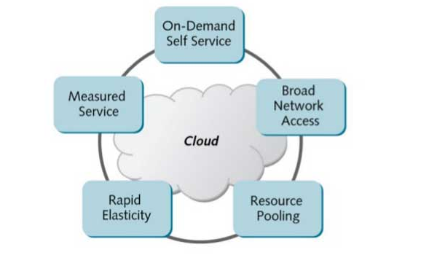
Characteristics of Cloud Computing
.

Slide 14
1 On-Demand Self Service
Enable Computing Resources as an when required.
No requirement of human interaction.
Facilitates consumer to leverage “ready to use” services or, enables to choose required services from the service catalog
Allows provisioning of resources using self-service interface-
Self service interface should be user friendly
.

Slide 15
2 Broad Network Access
Cloud services are accessed via the network, such as internet
Client Platforms are:-Desktop computer, laptop, tablets, workstations , thin clients,etc.
Eliminate need of access of service via particular client platform
Enables accessing the services from anywhere across the globe
.

Slide 16
3 Resource Pooling
IT Resources are pooled to serve multiple customers.
Based on Multi-Tenant Model- refers to an architecture and design by which multiple independent clients (tenants) are serviced using a single set of resources.
In a cloud, a client (tenant) could be a user, a user group, or an organization/company.
Virtualization provides ways for enabling multitenancy in cloud
Consumer has no knowledge of exact location of resource.
Resources are dynamically assigned and reassigned based on the consumer demand
.

Slide 17
4 Rapid Elasticity
Ability to scale IT resources rapidly, as required, to fulfill the changing needs without interruption of service
Resources can be both scaled up and scaled down dynamically
To the consumer, the cloud appears to be infinite
Consumers can start with minimal computing power and can expand their environment to any size
.

Slide 18
5 Measured Service
Consumers billed based on metered usage of cloud service.
Pricing is based on different service levels.
Resource usage can be monitored, controlled, audited, and reported.
Provides transparency for both the provider and consumer of the utilized service.
.

Slide 19
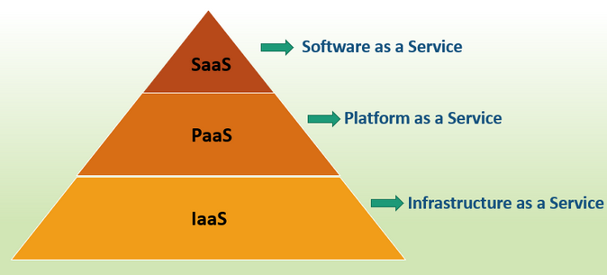
Cloud computing delivery models
.

Slide 20
Software as a Service (SaaS)
Applications are supplied by the service provider.
Consumers are relieved of capital investment in servers, software licensing, upgrading or maintaining software applications on their local systems.
The user does not manage or control the underlying cloud infrastructure or individual application capabilities.
Example : Microsoft office 365, Salesforce, Gmail, Google Docs.
.

Slide 21
Platform as a Service (PaaS)
Provides development environment and tools to create, develop, execute, test and deploy new applications in the cloud.
Developed applications using PaaS are provisioned as SaaS to the end-users.
Example : Microsoft Azure, Google App.
The user:
Has control over the deployed applications and, possibly, application hosting environment configurations.
Does not manage or control the underlying cloud infrastructure including network, servers, operating systems, or storage.
.

Slide 22
Infrastructure as a Service (IaaS)
Resources are distributed as a service .
Allows for dynamic scaling .
Has a variable cost, utility pricing model.
Generally includes multiple users on a single piece of hardware
Example : Amazon
.

Slide 23
Advantages of SaaS
Cost-Effective: Pay only for what you use.
Reduced time: Users can run most SaaS apps directly from their web browser without needing to download and install any software. This reduces the time spent in installation and configuration and can reduce the issues that can get in the way of the software deployment.
Accessibility: We can Access app data from anywhere.
Automatic updates: Rather than purchasing new software, customers rely on a SaaS provider to automatically perform the updates.
Scalability: It allows the users to access the services and features on-demand.
The various companies providing Software as a service are Cloud9 Analytics, Salesforce.com, Cloud Switch, Microsoft Office 365, Big Commerce, Eloqua, dropBox, and Cloud Tran.

Slide 24
Advantages of PaaS:
Simple and convenient for users: It provides much of the infrastructure and other IT services, which users can access anywhere via a web browser.
Cost-Effective: It charges for the services provided on a per-use basis thus eliminating the expenses one may have for on-premises hardware and software.
Efficiently managing the lifecycle: It is designed to support the complete web application lifecycle: building, testing, deploying, managing, and updating.
Efficiency: It allows for higher-level programming with reduced complexity thus, the overall development of the application can be more effective.
The various companies providing Platform as a service are Amazon Web services Elastic Beanstalk, Salesforce, Windows Azure, Google App Engine, cloud Bees and IBM smart cloud.

Slide 25
Disadvantages of Saas :
Limited customization: SaaS solutions are typically not as customizable as on-premises software, meaning that users may have to work within the constraints of the SaaS provider’s platform and may not be able to tailor the software to their specific needs.
Dependence on internet connectivity: SaaS solutions are typically cloud-based, which means that they require a stable internet connection to function properly. This can be problematic for users in areas with poor connectivity or for those who need to access the software in offline environments.
Security concerns: SaaS providers are responsible for maintaining the security of the data stored on their servers, but there is still a risk of data breaches or other security incidents.
Limited control over data: SaaS providers may have access to a user’s data, which can be a concern for organizations that need to maintain strict control over their data for regulatory or other reasons.

Slide 26
Disadvantages of Paas:
Limited control over infrastructure: PaaS providers typically manage the underlying infrastructure and take care of maintenance and updates, but this can also mean that users have less control over the environment and may not be able to make certain customizations.
Dependence on the provider: Users are dependent on the PaaS provider for the availability, scalability, and reliability of the platform, which can be a risk if the provider experiences outages or other issues.
Limited flexibility: PaaS solutions may not be able to accommodate certain types of workloads or applications, which can limit the value of the solution for certain organizations.

Slide 27
Advantages of IaaS:
Cost-Effective: Eliminates capital expense and reduces ongoing cost and IaaS customers pay on a per-user basis, typically by the hour, week, or month.
Website hosting: Running websites using IaaS can be less expensive than traditional web hosting.
Security: The IaaS Cloud Provider may provide better security than your existing software.
Maintenance: There is no need to manage the underlying data center or the introduction of new releases of the development or underlying software. This is all handled by the IaaS Cloud Provider.

Slide 28
Disadvantages of laaS :
Limited control over infrastructure: IaaS providers typically manage the underlying infrastructure and take care of maintenance and updates, but this can also mean that users have less control over the environment and may not be able to make certain customizations.
Security concerns: Users are responsible for securing their own data and applications, which can be a significant undertaking.
Limited access: Cloud computing may not be accessible in certain regions and countries due to legal policies.

Slide 29
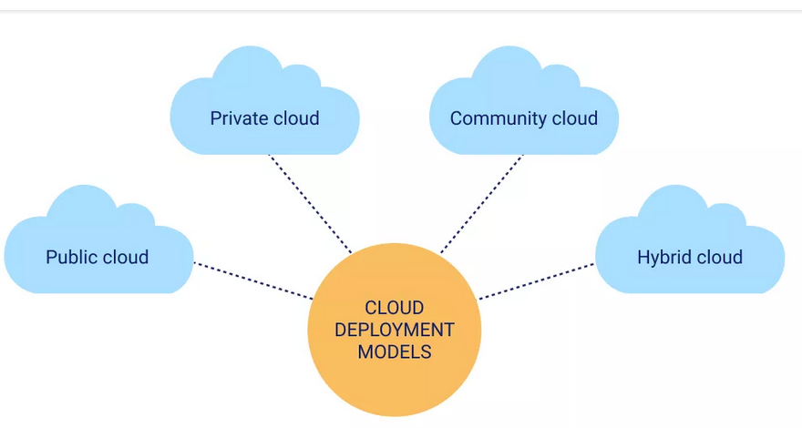
Cloud deployment models
https://www.sciencedirect.com/topics/computer-science/cloud-deployment-model
.

Slide 30
The cloud deployment model identifies the specific type of cloud environment based on ownership, scale, and access, as well as the cloud’s nature and purpose.
The location of the servers you’re utilizing and who controls them are defined by a cloud deployment model. It specifies how your cloud infrastructure will look, what you can change, and whether you will be given services or will have to create everything yourself.
Cloud Deployment Models - GeeksforGeeks

Slide 31
Public cloud
The public cloud makes it possible for anybody to access systems and services. The infrastructure in this cloud model is owned by the entity that delivers the cloud services, not by the consumer. It is a type of cloud hosting that allows customers and users to easily access systems and services. This form of cloud computing is an excellent example of cloud hosting, in which service providers supply services to a variety of customers. In this arrangement, storage backup and retrieval services are given for free, as a subscription, or on a per-user basis. For example, Google App Engine.
.

Slide 32
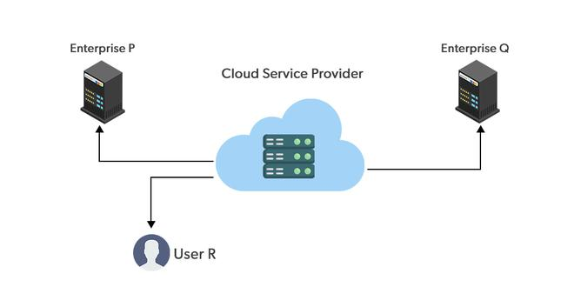

Slide 33
Advantages of the Public Cloud Model
Minimal Investment: Because it is a pay-per-use service, there is no substantial upfront fee, making it excellent for enterprises that require immediate access to resources.
No setup cost: The entire infrastructure is fully subsidized by the cloud service providers, thus there is no need to set up any hardware.
Infrastructure Management is not required: Using the public cloud does not necessitate infrastructure management.
No maintenance: The maintenance work is done by the service provider (not users).
Dynamic Scalability: To fulfill your company’s needs, on-demand resources are accessible.

Slide 34
Disadvantages of the Public Cloud Model
Less secure: Public cloud is less secure as resources are public so there is no guarantee of high-level security.
Low customization: It is accessed by many public so it can’t be customized according to personal requirements.

Slide 35
Private Cloud
It’s a one-on-one environment for a single user (customer). There is no need to share your hardware with anyone else. The distinction between private and public clouds is in how you handle all of the hardware. It is also called the “internal cloud” & it refers to the ability to access systems and services within a given border or organization. The cloud platform is implemented in a cloud-based secure environment that is protected by powerful firewalls and under the supervision of an organization’s IT department. The private cloud gives greater flexibility of control over cloud resources.

Slide 36
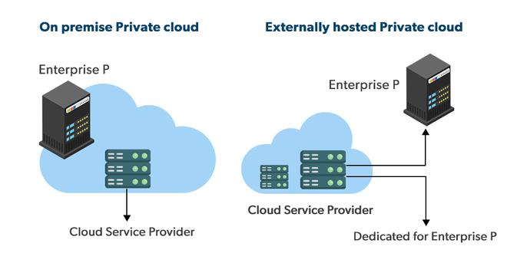

Slide 37
Advantages of the Private Cloud Model
Better Control: You are the sole owner of the property. You gain complete command over service integration, IT operations, policies, and user behavior.
Data Security and Privacy: It’s suitable for storing corporate information to which only authorized staff have access. By segmenting resources within the same infrastructure, improved access and security can be achieved.
Supports Legacy Systems: This approach is designed to work with legacy systems that are unable to access the public cloud.
Customization: Unlike a public cloud deployment, a private cloud allows a company to tailor its solution to meet its specific needs.

Slide 38
Disadvantages of the Private Cloud Model
Less scalable: Private clouds are scaled within a certain range as there is less number of clients.
Costly: Private clouds are more costly as they provide personalized facilities.

Slide 39
Private Cloud
private cloud is typically infrastructure used by a single organization.
Such infrastructure may be managed by the organization itself to support various user groups, or it could be managed by a service provider that takes care of it either on-site or off-site.
Private clouds are more expensive than public clouds due to the capital expenditure involved in acquiring and maintaining them.
Private clouds are better able to address the security and privacy concerns of organizations today.
https://www.sciencedirect.com/topics/computer-science/cloud-deployment-model
.

Slide 40
Hybrid Cloud
By bridging the public and private worlds with a layer of proprietary software, hybrid cloud computing gives the best of both worlds. With a hybrid solution, you may host the app in a safe environment while taking advantage of the public cloud’s cost savings. Organizations can move data and applications between different clouds using a combination of two or more cloud deployment methods, depending on their needs.

Slide 41
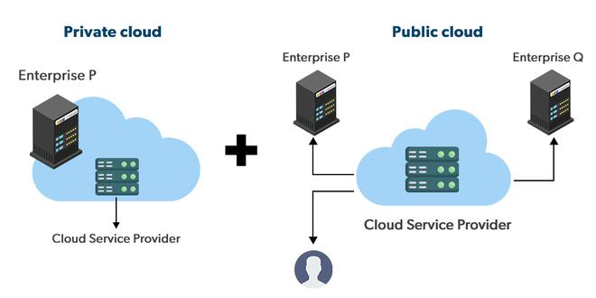

Slide 42
Hybrid Cloud
In a hybrid cloud, an organization makes use of interconnected private and public cloud infrastructure.
Many organizations make use of this model when they need to scale up their IT infrastructure rapidly, such as when leveraging public clouds to supplement the capacity available within a private cloud.
For example, if an online retailer needs more computing resources to run its Web applications during the holiday season it may attain those resources via public clouds.
https://www.sciencedirect.com/topics/computer-science/cloud-deployment-model
.

Slide 43
Advantages of the Hybrid Cloud Model
Flexibility and control: Businesses with more flexibility can design personalized solutions that meet their particular needs.
Cost: Because public clouds provide scalability, you’ll only be responsible for paying for the extra capacity if you require it.
Security: Because data is properly separated, the chances of data theft by attackers are considerably reduced.

Slide 44
Disadvantages of the Hybrid Cloud Model
Difficult to manage: Hybrid clouds are difficult to manage as it is a combination of both public and private cloud. So, it is complex.
Slow data transmission: Data transmission in the hybrid cloud takes place through the public cloud so latency occurs.

Slide 45
Community Cloud
It allows systems and services to be accessible by a group of organizations. It is a distributed system that is created by integrating the services of different clouds to address the specific needs of a community, industry, or business. The infrastructure of the community could be shared between the organization which has shared concerns or tasks. It is generally managed by a third party or by the combination of one or more organizations in the community.

Slide 46
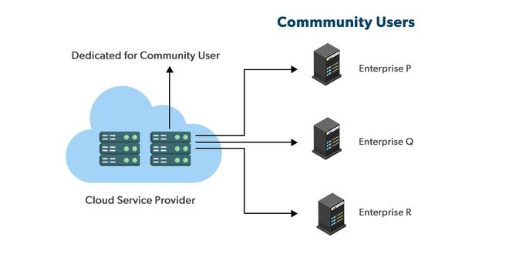

Slide 47
Advantages of the Community Cloud Model
Cost Effective: It is cost-effective because the cloud is shared by multiple organizations or communities.
Security: Community cloud provides better security.
Shared resources: It allows you to share resources, infrastructure, etc. with multiple organizations.
Collaboration and data sharing: It is suitable for both collaboration and data sharing.

Slide 48
Disadvantages of the Community Cloud Model
Limited Scalability: Community cloud is relatively less scalable as many organizations share the same resources according to their collaborative interests.
Rigid in customization: As the data and resources are shared among different organizations according to their mutual interests if an organization wants some changes according to their needs they cannot do so because it will have an impact on other organizations.

Slide 49
Community Cloud
supports multiple organizations sharing computing resources that are part of a community;
Examples include universities cooperating in certain areas of research, or police departments within a county or state sharing computing resources.
Access to a community cloud environment is typically restricted to the members of the community.
https://www.sciencedirect.com/topics/computer-science/cloud-deployment-model
.

Slide 50
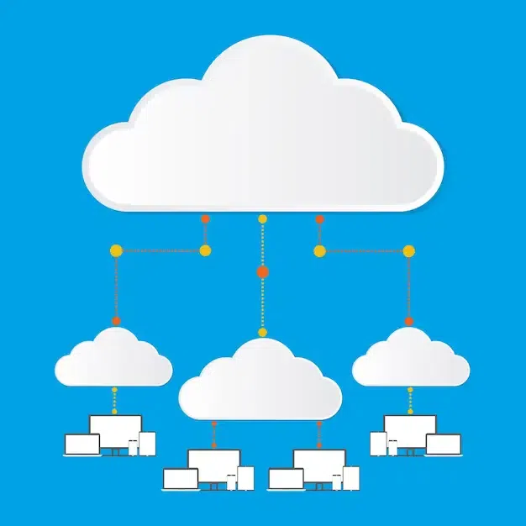
Multi-Cloud

Slide 51
Advantages of the Multi-Cloud Model
You can mix and match the best features of each cloud provider’s services to suit the demands of your apps, workloads, and business by choosing different cloud providers.
Reduced Latency: To reduce latency and improve user experience, you can choose cloud regions and zones that are close to your clients.
High availability of service: It’s quite rare that two distinct clouds would have an incident at the same moment. So, the multi-cloud deployment improves the high availability of your services.

Slide 52
Disadvantages of the Multi-Cloud Model
Complex: The combination of many clouds makes the system complex and bottlenecks may occur.
Security issue: Due to the complex structure, there may be loopholes to which a hacker can take advantage hence, makes the data insecure.

Slide 53
Choosing Deployment Models
Cost: Cost is an important factor for the cloud deployment model as it tells how much amount you want to pay for these things.
Scalability: Scalability tells about the current activity status and how much we can scale it.
Easy to use: It tells how much your resources are trained and how easily can you manage these models.
Compliance: Compliance tells about the laws and regulations which impact the implementation of the model.
Privacy: Privacy tells about what data you gather for the model.

Slide 54
Major challenges
Availability of service; what happens when the service provider cannot deliver?
Diversity of services, data organization, user interfaces available at different service providers limit user mobility;
once a customer is hooked to one provider it is hard to move to another.
Data confidentiality and auditability, a serious problem.
Data transfer bottleneck; many applications are data-intensive.
.

Slide 55
Cloud Challenges – Consumers Perspective
Security and Regulation
Consumers are indecisive to transfer control of sensitive data
Regulation may prevent organizations to use Cloud services
Network latency
Real time applications may suffer due to network latency and limited bandwidth
Supportability
Legacy of Custom applications may not be compatible with cloud platform
Interoperability
Lack of standardization across cloud-base platforms
.

Slide 56
Cloud Challenges – Providers Perspective
Service warranty and service cost
Resources must be kept ready to meet unpredictable demand
Heavy penalty, if SLA are not fulfilled
Huge numbers of software to manage
Huge number of applications and platform software to purchase
Return On Investment (ROI) is unpredictable
No standard cloud access interface
Cloud customers want open APIs
Need agreement among Cloud providers for standardization
.

Slide 57
Major challenges (contd)
Performance unpredictability, one of the consequences of resource sharing.
Resource management
Security and confidentiality;
Addressing these challenges provides good research opportunities
.

Slide 58
Ethical issues in Cloud Computing
Paradigm shift with implications on computing ethics:
The control is relinquished to third party services.
The data is stored on multiple sites administered by several organizations.
Multiple services interoperate across the network.
Implications
Unauthorized access.
Data corruption.
Infrastructure failure, and service unavailability.
.

Slide 59
Economics of Cloud
Cloud has changed the economics of IT
Cloud enables to move from a CAPEX (Capital Expenditure) to an OPEX (Operational Expenditure) model
Cloud provides the following key cost savings
- Infrastructure cost
- Management cost
- Power and energy cost
.

Slide 60
Cloud computing at Amazon
Amazon is a pioneer in Infrastructure-as-a-Service (IaaS).
AWS → IaaS cloud computing services launched in 2006.
The infrastructure consists of compute and storage servers interconnected by high-speed networks and supports a set of services.
An application developer:
Installs applications on a platform of his/her choice.
Manages resources allocated by Amazon
.

Slide 61
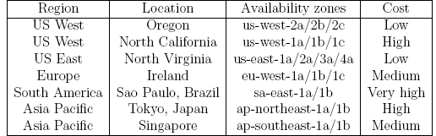
AWS regions and availability zones
Amazon offers cloud services through a network of data centers on several continents.
In each region there are several availability zones interconnected by high-speed networks.
An availability zone is a data center consisting of a large number of servers.
.

Slide 62
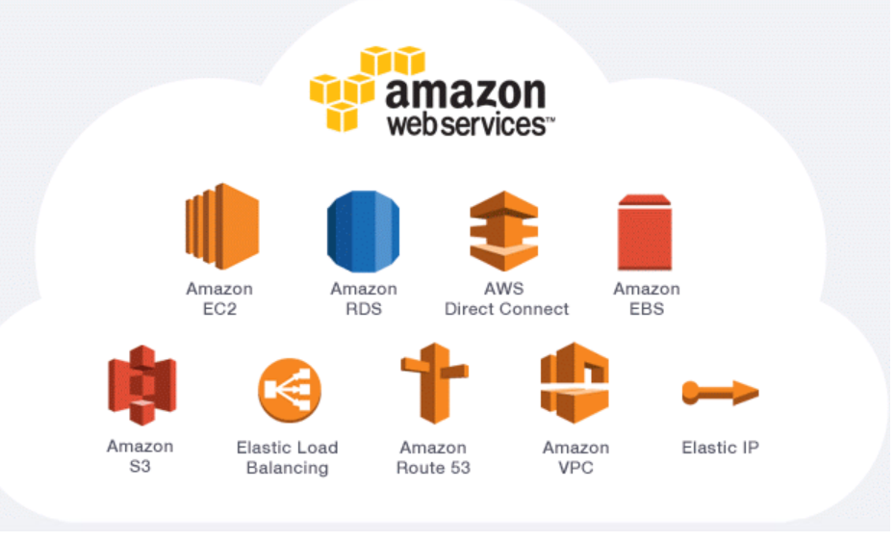
Notes:
https://medium.com/@thinkwik/everything-you-wanted-to-know-about-amazon-web-services-aws-25376e8462a9

Slide 63
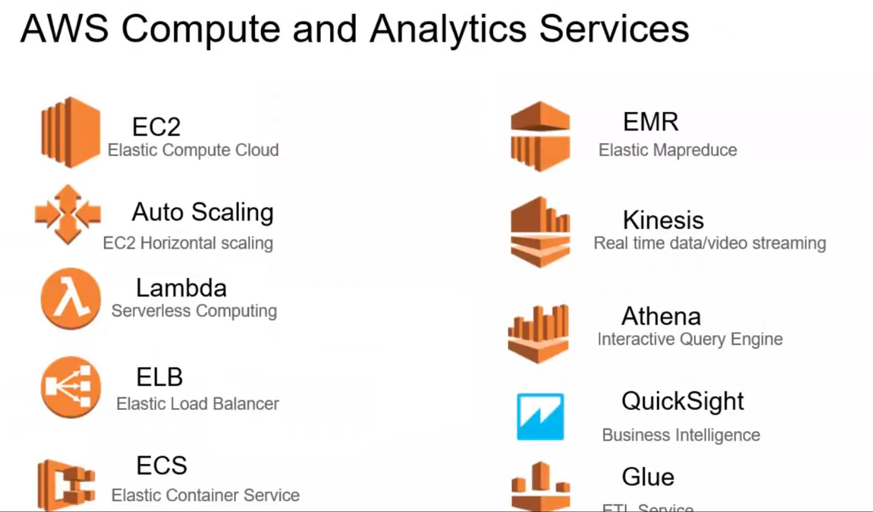
Notes:
5.40

Slide 64
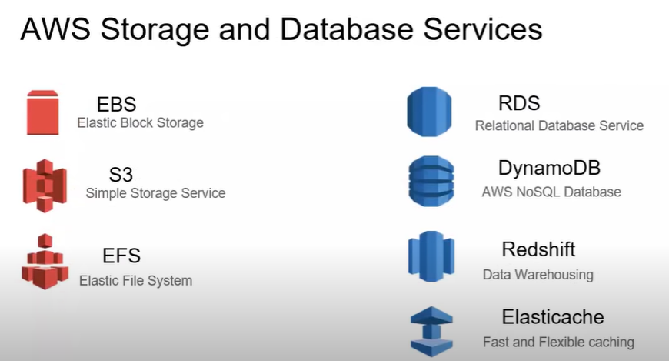
Notes:
https://www.youtube.com/watch?v=Z3SYDTMP3ME

Slide 65
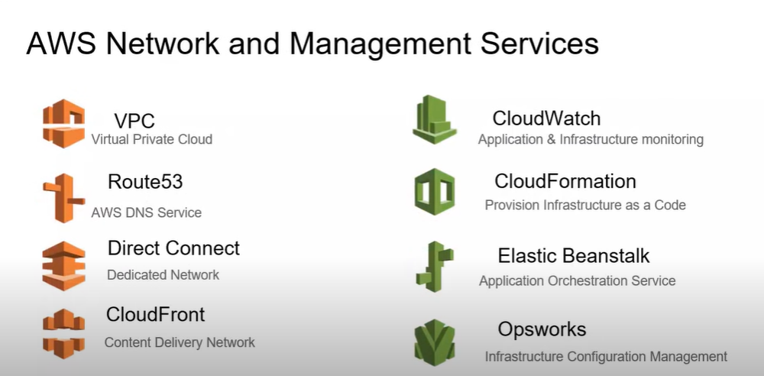

Slide 66
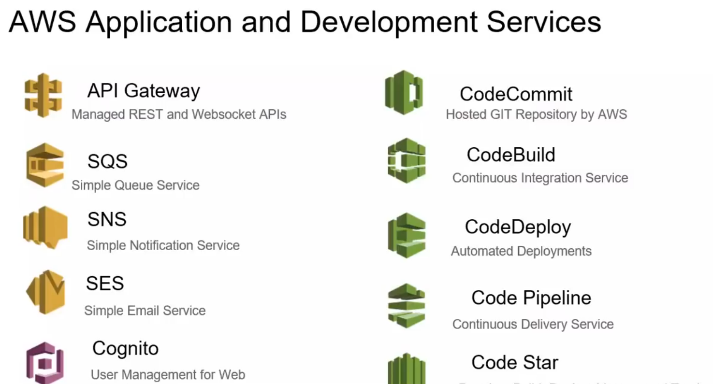

Slide 67
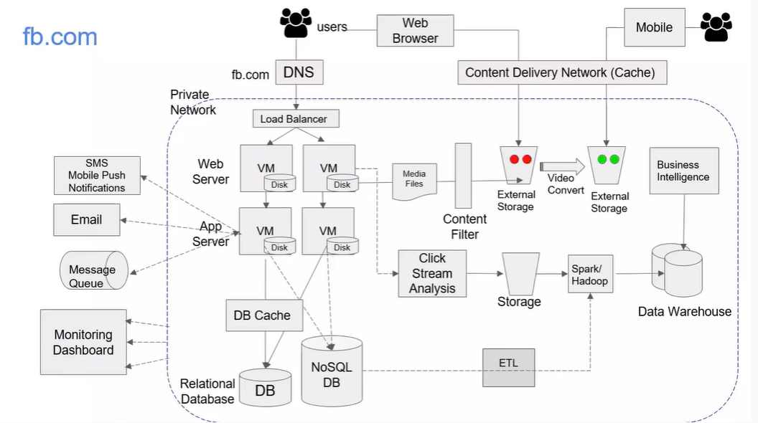

Slide 68
Links to videos
1. Azure
https://www.youtube.com/watch?v=GefJyITCu0k
2. GCP
https://www.youtube.com/watch?v=OzwSBbuHY-0&list=PLcnJIHtHiTA2Jp3klIkeHiwqGrxjXBzh6&index=1
3. AWS
https://www.youtube.com/watch?v=Z3SYDTMP3ME&t=1757s

Slide 69
Amazon Web Services
AWS Management Console : allows users to access the services offered by AWS
Elastic Cloud Computing (EC2) : allows a user to launch a variety of operating systems.
Simple Queuing Service (SQS) : allows multiple EC2 instances to communicate with one another.
Simple Storage Service (S3), Simple DB, and Elastic Bloc Storage (EBS) - storage services.
Cloud Watch : supports performance monitoring.
Auto Scaling : supports elastic resource management.
Virtual Private Cloud : create a virtual network.
.

Slide 70
EC2 – Elastic Compute Cloud
EC2 : web service for launching instances of an application under several operating systems, such as:
Several Linux distributions.
Microsoft Windows Server 2003 and 2008.
OpenSolaris.
A user can
Load an EC2 instance with a custom application environment.
Manage network’s access permissions.
Run the image using as many or as few systems as desired.
.

Slide 71
EC2 – Elastic Compute Cloud (contd)
EC2 instances boot from an AMI (Amazon Machine Image) digitally signed and stored in S3.
Users can access:
Images provided by Amazon.
Customize an image and store it in S3.
An EC2 instance is characterized by the resources it provides:
VC (Virtual Computers) – virtual systems running the instance.
CU (Compute Units) – measure computing power of each system.
Memory.
I/O capabilities
.

Slide 72
S3 – Simple Storage System
Service designed to store large objects; an application can handle an unlimited number of objects ranging in size from 1 byte to 5 TB.
An object is stored in a bucket and retrieved via a unique, developer-assigned key; a bucket can be stored in a Region selected by the user.
Supports a minimal set of functions: write, read, and delete.
The object names are global.
S3 maintains for each object: the name, modification time, an access control list, and up to 4 KB of user-defined metadata.
.

Slide 73
S3 – Simple Storage System (contd)
Authentication mechanisms ensure that data is kept secure.
Objects can be made public, and rights can be granted to other users.
S3 computes the MD5 of every object written and returns it in a field called ETag.
A user is expected to compute the MD5 of an object stored or written and compare this with the ETag;
if the two values do not match, then the object was corrupted during transmission or storage.
.

Slide 74
Elastic Block Store (EBS)
Provides persistent block level storage volumes for use with EC2 instances; suitable for database applications, file systems, and applications using raw data devices.
An EC2 instance may mount multiple volumes, but a volume cannot be shared among multiple instances.
EBS supports the creation of snapshots of the volumes attached to an instance and then uses them to restart the instance.
.

Slide 75
SimpleDB
Non-relational data store. Supports store and query functions traditionally provided only by relational databases.
Supports high performance Web applications; users can store and query data items via Web services requests.
Creates multiple geographically distributed copies of each data item.
It manages automatically:
The infrastructure provisioning.
Hardware and software maintenance.
Replication and indexing of data items.
Performance tuning.
.

Slide 76
SQS - Simple Queue Service
Hosted message queues are accessed through standard SOAP and Query interfaces.
Supports automated workflows - EC2 instances can coordinate by sending and receiving SQS messages.
Applications using SQS can run independently and asynchronously, and do not need to be developed with the same technologies.
A received message is “locked'' during processing; if processing fails, the lock expires and the message is available again.
Queue sharing can be restricted by IP address and time-of-day
.

Slide 77
CloudWatch
Monitoring infrastructure used by application developers, users, and system administrators to collect and track metrics important for optimizing the performance of applications and for increasing the efficiency of resource utilization.
Without installing any software a user can monitor either seven or eight pre-selected metrics and then view graphs and statistics for these metrics.
When launching an Amazon Machine Image (AMI) the user can start the CloudWatch and specify the type of monitoring:
Basic Monitoring - free of charge; collects data at five-minute intervals for up to seven metrics.
Detailed Monitoring - subject to charge; collects data at one minute interval.
.

Slide 78
CloudWatch
Terms associated with CloudWatch
Dashboards: CloudWatch is used to create dashboards to show what is happening with our AWS environment.
Alarms: Allows us to set alarms to notify whenever a particular threshold is hit.
Logs: CloudWatch logs help to aggregate, monitor, and store logs.
Events: CloudWatch help to respond to state changes to your AWS resources.
.

Slide 79
CloudFront : web service for content delivery.
Elastic Load Balancer : automatically distributes the incoming requests across multiple instances of the application..
Elastic MapReduce (EMR) : supports processing of large amounts of data using a hosted Hadoop running on EC2.
DynamoDB : scalable and low-latency fully managed NoSQL database service.
.

Slide 80
Content Delivery Network (CDN)
CDN is a network of distributed servers containing content replicas that serve by delivering web-content against each request from a suitable content server based on the geographic location of the origin of the request and the location of content server.
The service is particularly effective in speeding up the delivery of web-content during high traffic in the network.
.

Slide 81
Cloud Front
CloudFront is a content delivery service offered by Amazon.
The service was launched in 2008 and operates on a pay-as-use basis.
CloudFront delivers content through a worldwide network of edge locations.
The service operates from more than 50 edge locations throughout the world.
It works seamlessly with S3 but can be used as stand-alone too.
.

Slide 82
Cloud Front
Usage
When a client requests a page using that domain name, CF identifies the best edge location to serve our content.
If an edge location doesent have a copy of the file then CF identifies the origin server from URL and copies contents to edge location.
Amazon CloudFront uses the expiration period on files( default 24 hours)
.

Slide 83
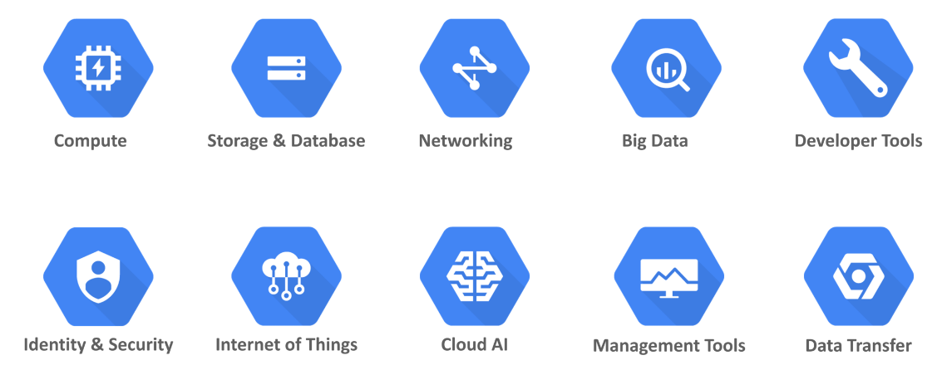
Google Cloud Services

Slide 84
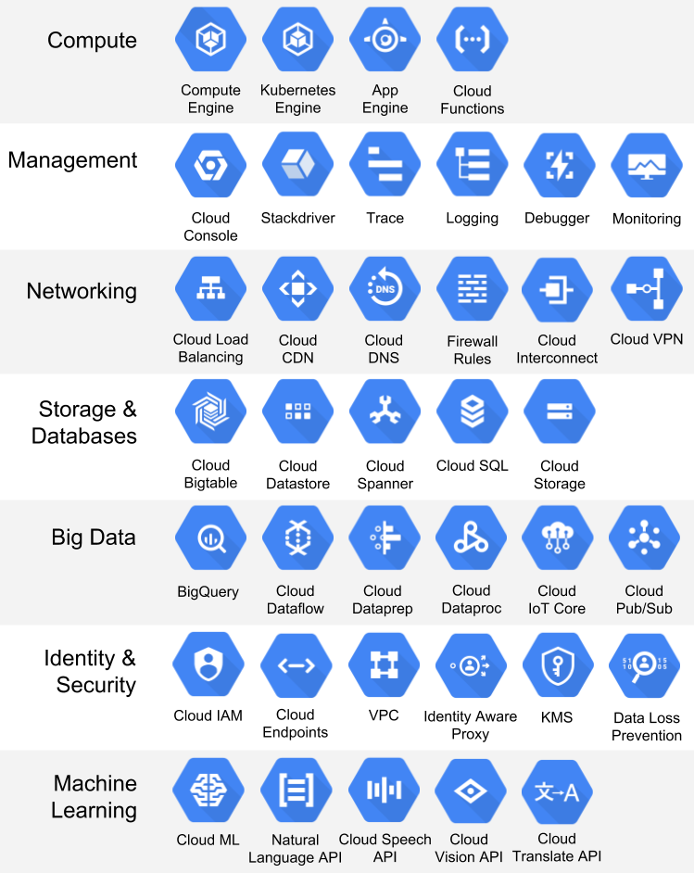
Notes:
https://www.easydeploy.io/blog/google-cloud/
https://www.edureka.co/blog/what-is-google-cloud-platform/

Slide 85
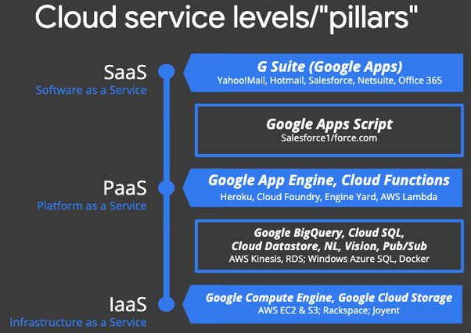
Notes:
https://www.easydeploy.io/blog/google-cloud/

Slide 86
Microsoft Azure
Azure is a cloud computing platform which was launched by Microsoft in February 2010.
Azure provides developers with a development platform to create, test, manage and deploy new web-based apps or to improve existing applications with cloud-based capabilities.
Azure also makes provision for users to utilize virtual machines of both windows and linux based operating systems.
.

Slide 87
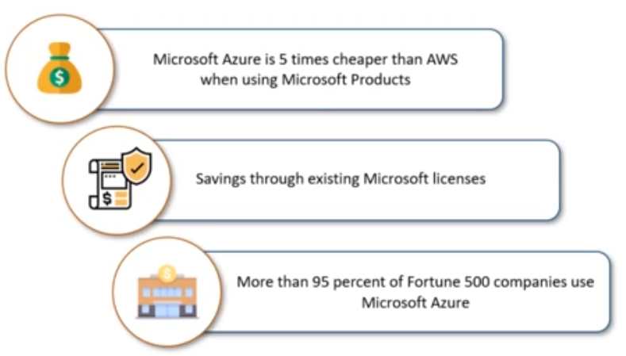
.

Slide 88
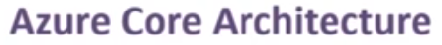
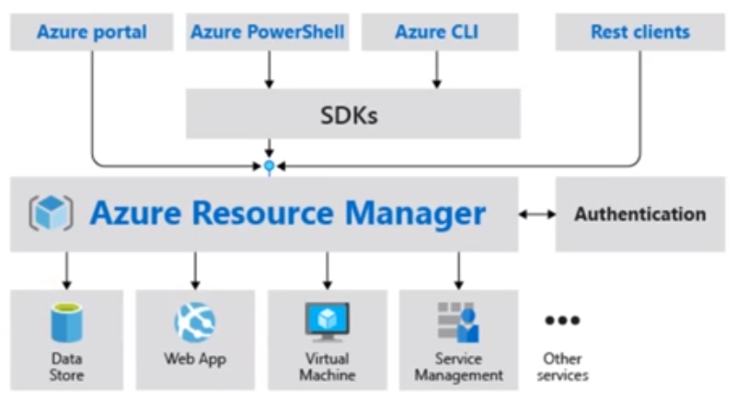
.

Slide 89
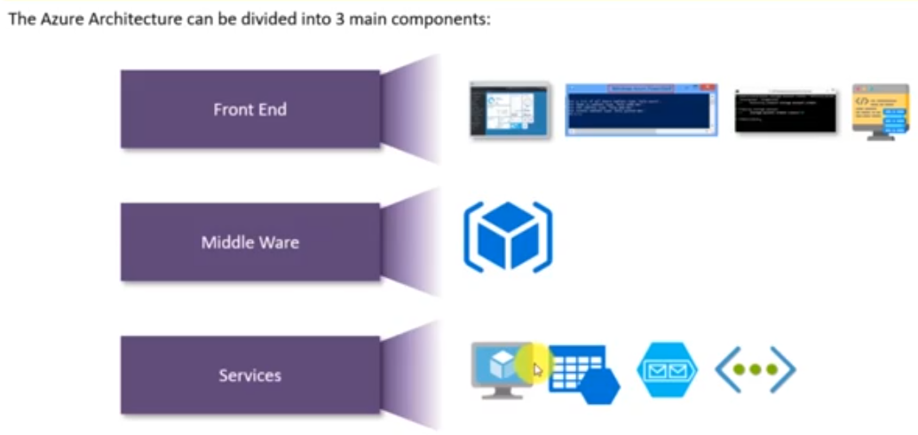
.

Slide 90
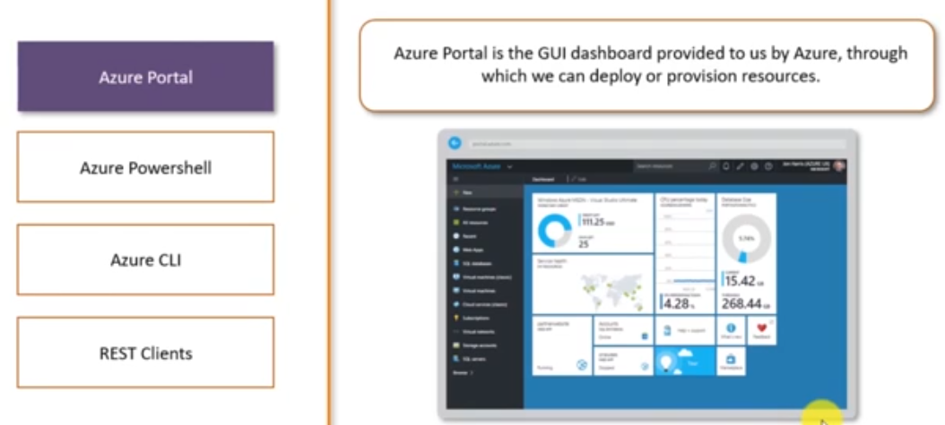
.

Slide 91
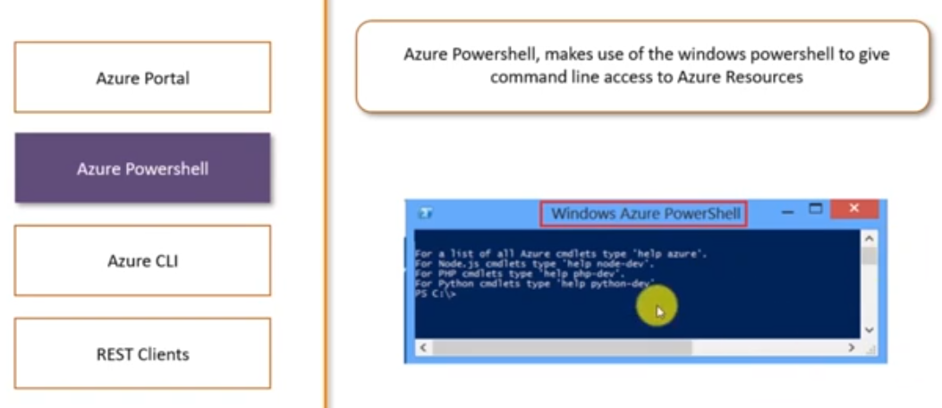
.

Slide 92
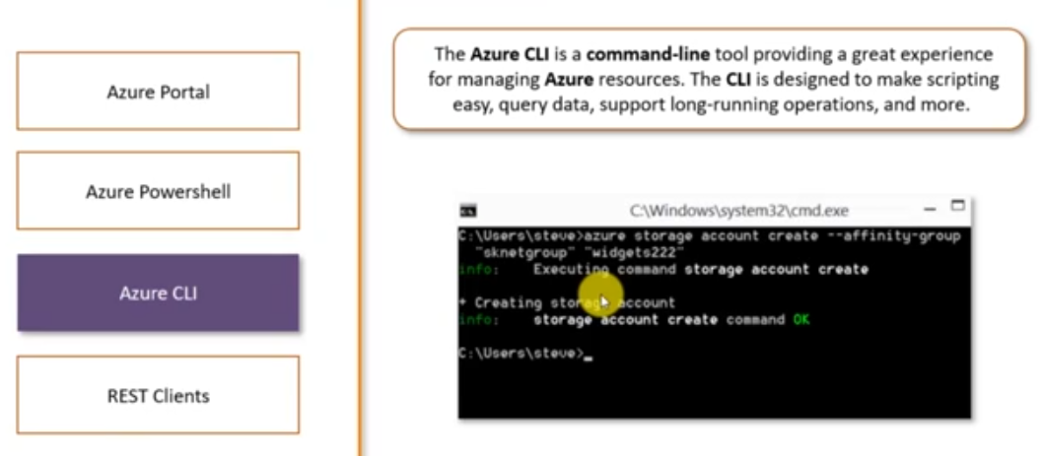
Azure PowerShell provides the New-AzVM command that creates a virtual machine
to create a Virtual Machine using Azure CLI we must use the command az vm create.
.

Slide 93
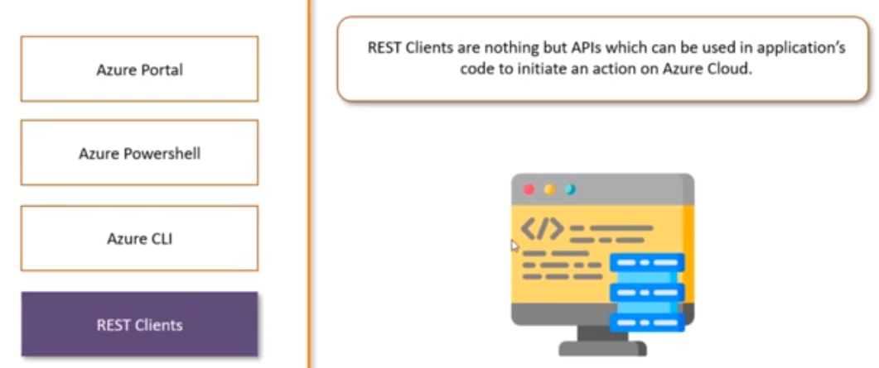
.

Slide 94
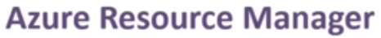
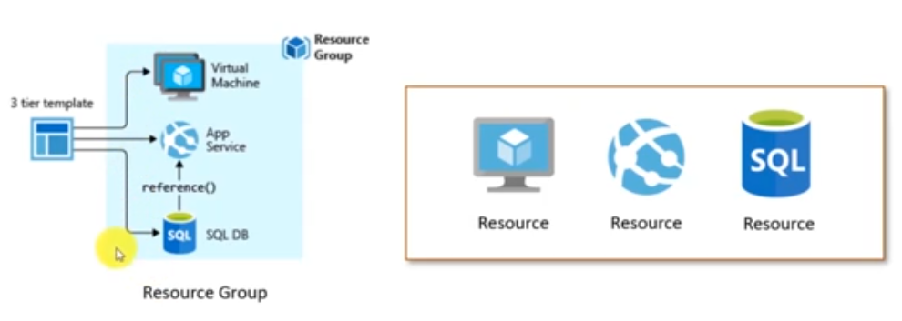
.

Slide 95
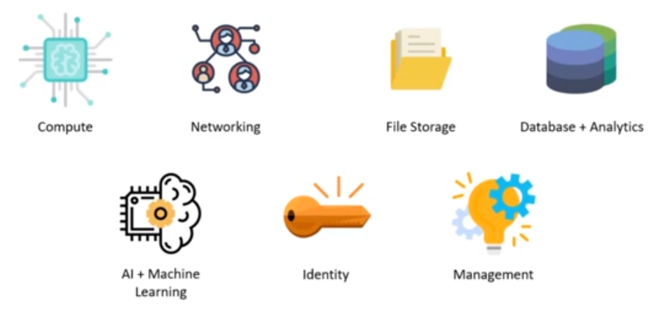
.

Slide 96
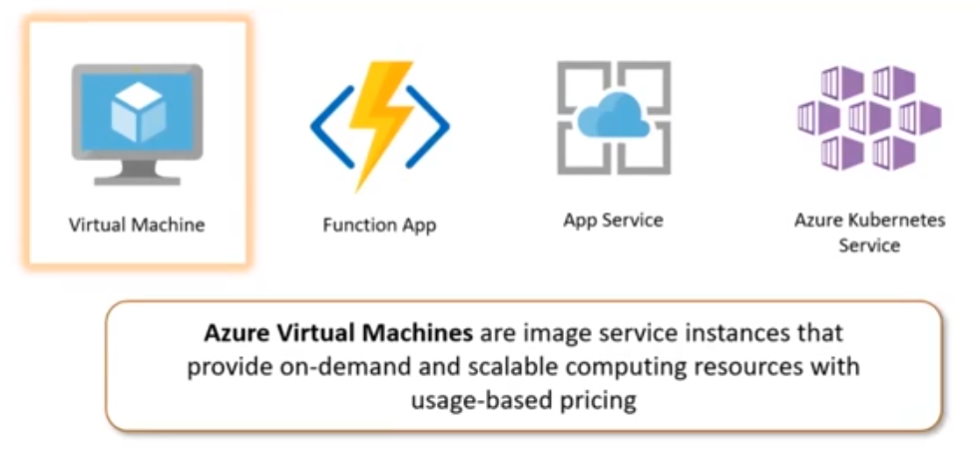
.

Slide 97
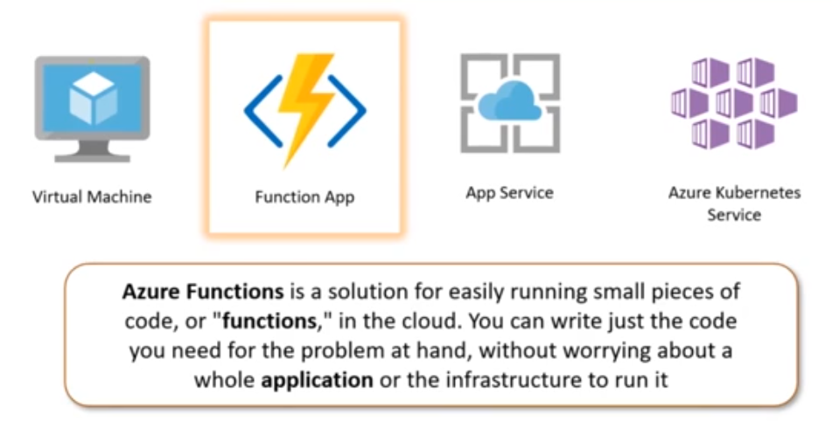
.

Slide 98
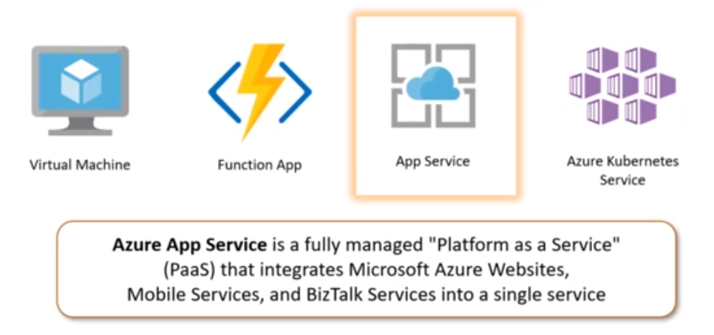
.

Slide 99
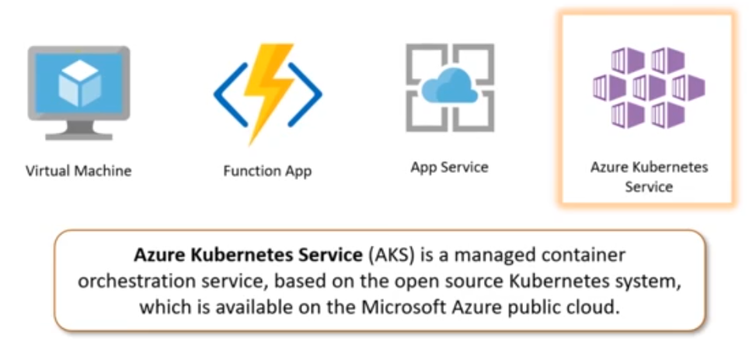
.

Slide 100
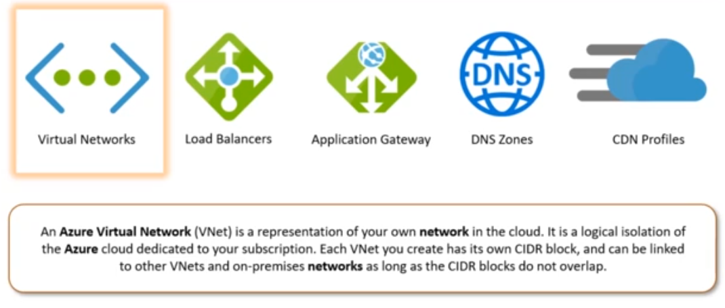
.

Slide 101
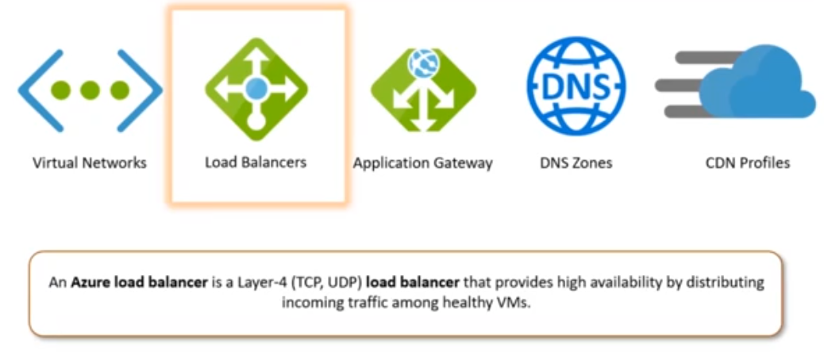
.

Slide 102
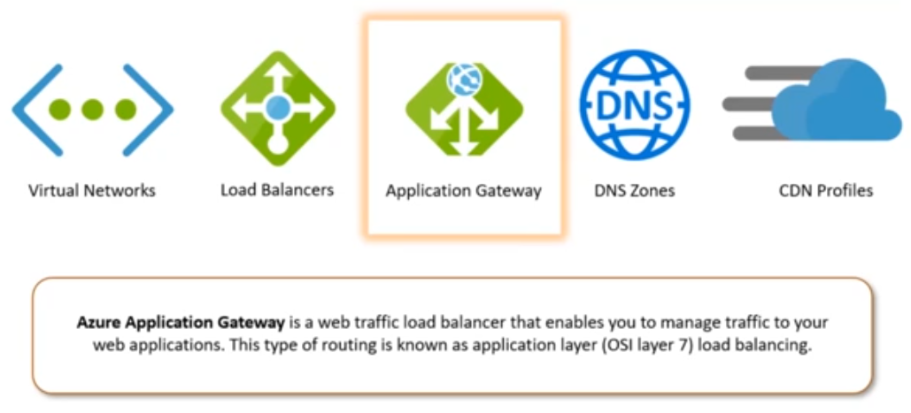
.

Slide 103
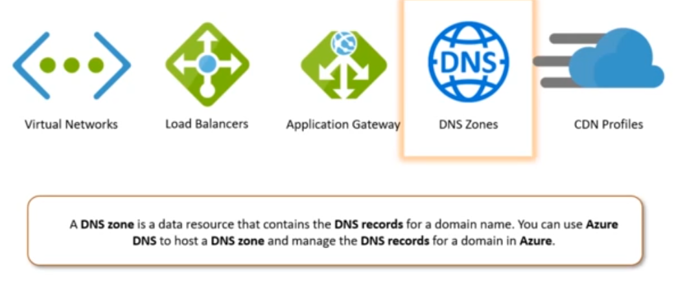
.

Slide 104
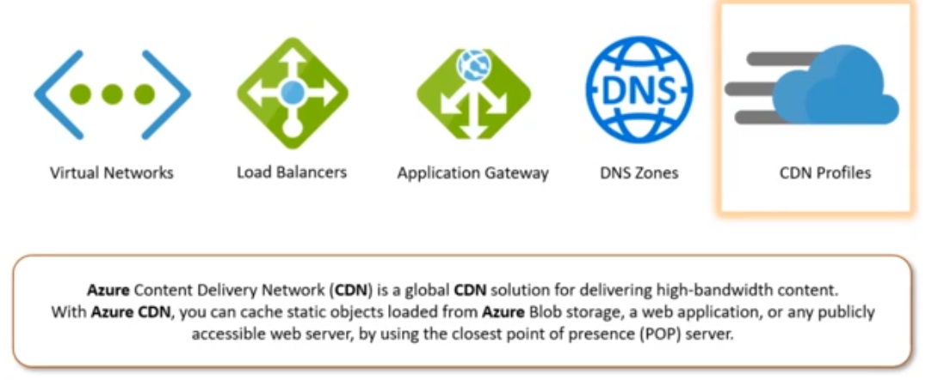
.

Slide 105
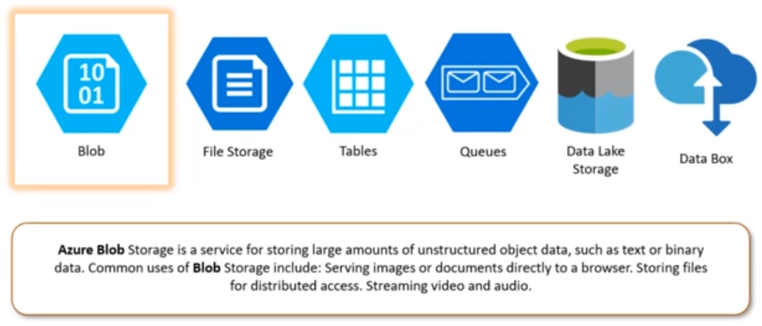
.

Slide 106
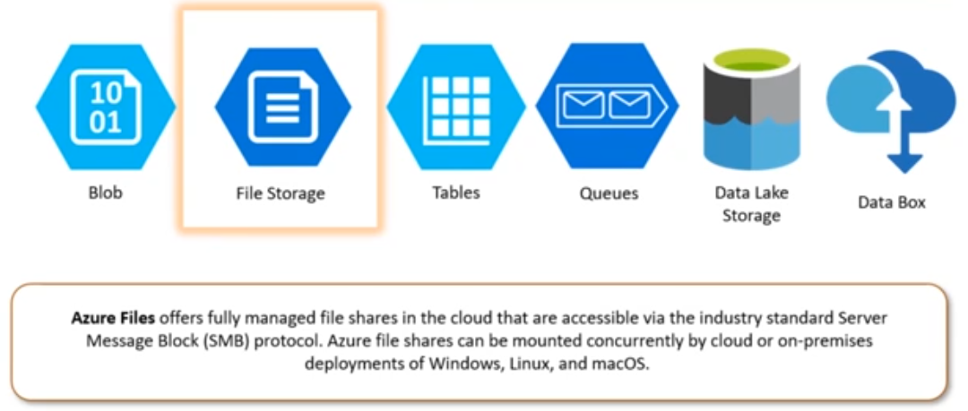
.

Slide 107
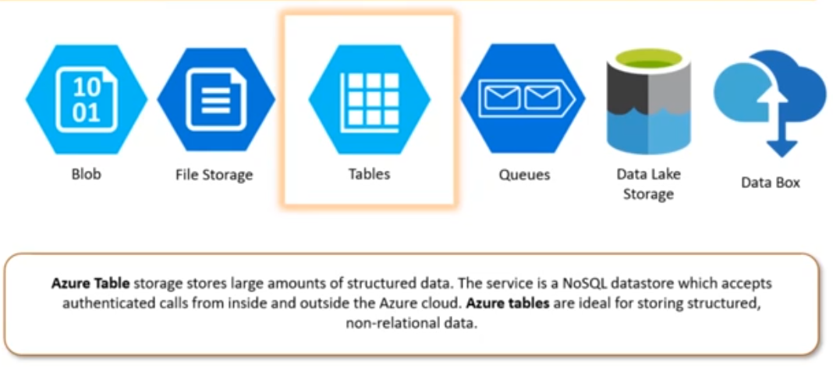
.

Slide 108
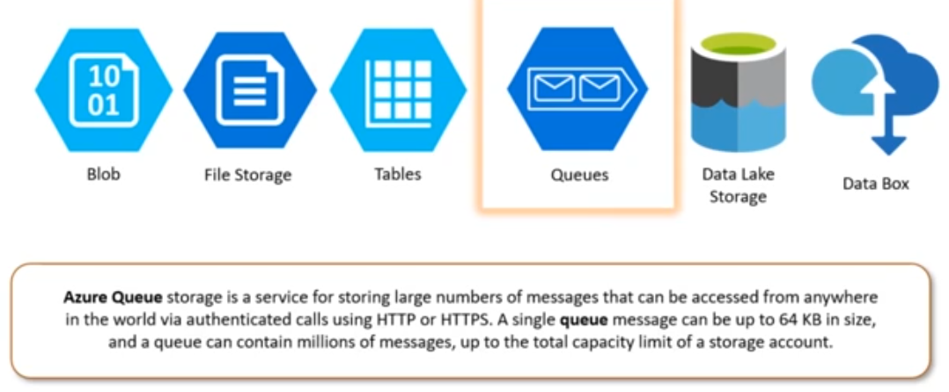
.

Slide 109
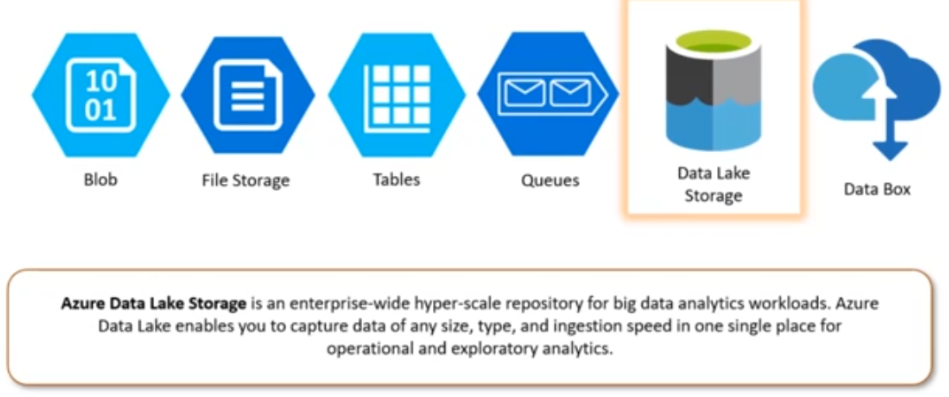
.

Slide 110
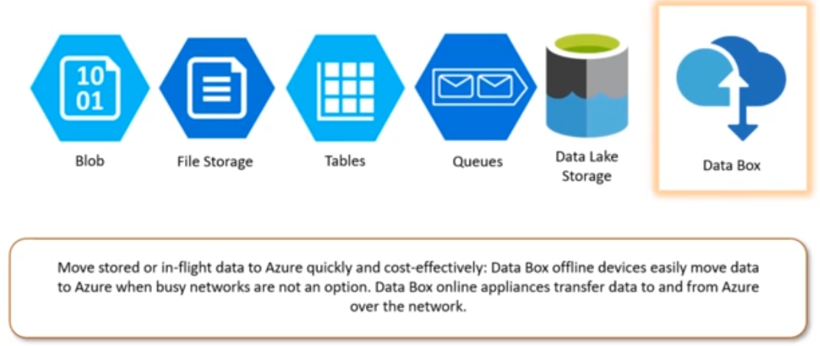
.

Slide 111
Things to study from Exam point of view
Any 5 Services in detail under AWS or Google Cloud or Azure
Comparison of above 3 Providers
Comparison of delivery models
Comparison of deployment models
Deployment models
Service delivery models
Ref: AWS services Overview pdf
GCP Tutorial javatpoint
AZURE services Handbook

